Slide 1
Pharmacological Intervention in Substance Use Disorder
Dr M Suresh Kumar MD DPM MPH
Psymed Hospital, Chennai
IPS Kerala State: Midterm CME-2016
Kollam
May 22 2016

Slide 2
Outline
Biological basis of Substance Use Disorder
Pharmacotherapy for Alcohol Use Disorder
Pharmacotherapy for Substance Use Disorder

Slide 3
Biological basis for
Substance Use Disorder

Slide 4
Shift from alcohol/drug ‘liking’ to alcohol/drug ‘wanting’
Continued exposure to alcohol/drug
Pathological shift of the alcohol user’s hedonic set point
Dysregulation of brain reward systems
Loss of control over alcohol/drug intake and compulsive use

Slide 5
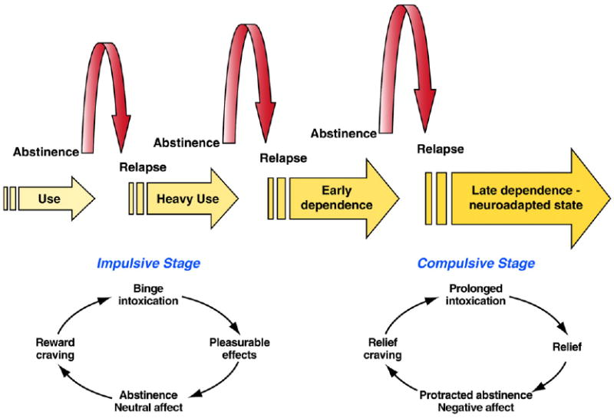
Progression from use to dependence
Koob, Brain Res. 2009 13; 1293: 61–75.
Notes:
Schematic for the progression of alcohol dependence over time, illustrating the shift in
underlying motivational mechanisms. From initial, positively reinforcing, pleasurable drug
effects, the addictive process progresses over time to being maintained by negatively
reinforcing relief from a negative emotional state.

Slide 6
Circuitry – Drug dependence
Red: Pleasure
Purple: Memory and learning
Blue: Cognitive Control
Green: Motivation
Baler & Volkow, TRENDS in Molecular Medicine Vol.12 No.12; 2006

Slide 7
Alcohol/Drug and Stress systems
Alcohol/drug has been shown to produce dysregulations in brain stress systems:
  alterations in adrenocorticotrophic hormone
  alterations in corticosterone
  alterations in corticotropin-releasing factor (CRF) activity
Koob, Neuron, 59, July 10, 2008

Slide 8
Neurobiology of Alcohol
Ethanol acts as a GABA-A agonist so increasing central inhibition
Ethanol as antagonist at the NMDA type of glutamate receptors so reducing central excitation.
The pleasurable effects are probably in part due to these interactions but may also involve interactions with endogenous opioids, dopamine and other amine systems.
D. J. Nutt, J Psychopharmacol 2006; 20; 318

Slide 9
Alcohol craving and neurotransmitters
Reward craving - dopaminergic dysfunction and dysfunction of opioid receptor transmission.
Relief craving - GABAergic and glutaminergic transmitter dysfunction.
Obsessive craving - serotoninergic dysfunction

Slide 10
Pharmacotherapy for
Alcohol Use Disorder

Slide 11
Pharmacological drugs used in the treatment of alcohol dependence
Disulfiram
Acamprosate
Naltrexone
Topiramate
Baclofen

Slide 12
Disulfiram

Slide 13
Disulfiram
Inhibits aldehyde dehydrogenase, a key enzyme involved in the metabolism of alcohol
Accumulation of acetaldehyde after drinking alcohol causes unpleasant effects such as nausea and vomiting, headache, flushing, palpitations and hypotension
Its efficacy is linked to the fear of these aversive reactions, and is enhanced by supervision

Slide 14
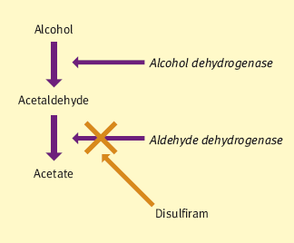
Disulfiram
Watson & Lingford-Hughes, Psychiatry 6:7, 2007

Slide 15
Disulfiram
More than 500 mg per day of disulfiram are needed for maximum inhibition of ALDH, but that dose would produce unacceptable side-effects
Disulfiram has both relatively benign side-effects - a bad taste, sedation, a rash, and temporary impotence
Rarer but more severe sequelae are neuropathies, depression, psychotic symptoms, an increase in liver function tests, and severe hepatitis
Schuckit, Lancet Jan 2009

Slide 16
Acamprosate

Slide 17
Acamprosate
Structurally similar to γ-aminobutyric acid
Inhibit the N-methyl-D-aspartic acid (NMDA) glutamate receptor hyperactivity that occurs during protracted withdrawal
NMDA receptor modulator, rather than a direct antagonist
Acts on the calcium channels - reduces central nervous system hyperexcitability induced by suppression of alcohol

Slide 18
Acamprosate
Its mechanism of action is to rectify imbalance in the GABA and glutamate systems
Acamprosate helps balance disrupted neurotransmission, mainly by decreasing the overexcitation caused by alcohol dependence
Overall bioavailability is relatively low (absorption through paracellular route); food limits absoption
No drug interactions with other drugs, including naltrexone, disulfiram, diazepam, or alcohol

Slide 19
Acamprosate
It works by reducing craving and the urge to drink
Drug increases the time to relapse, decreases the number of drinks per drinking day, or helps to maintain abstinence, with a rate of improved outcome similar to naltrexone
Schuckit, Lancet Jan 2009

Slide 20
Acamprosate: Efficacy
A meta-analysis of the 24 trials - a statistically significant effect of acamprosate in comparison with placebo in returning to any drinking and cumulative duration of abstinence.
Acamprosate reduced the risk of returning to any drinking by 86% and increased the cumulative duration of abstinence by 11% compared with placebo during treatment.
Individuals on acamprosate had a 9% lower risk of returning to any drinking and a 9% higher continuous abstinence duration in comparison with placebo after discontinuing treatment.
Cochrane Review, 2006

Slide 21
Acamprosate:
Compliance and patient response
Three times daily dosing and side effects of acamprosate (eg, nausea, diarrhea) cause disruptions in compliance
Mean adherence to acamprosate monotherapy was only 69.7%
Genetic variations in a gene for GATA-binding protein (GATA4) significantly associated with relapse risk; the risk was primarily driven by acamprosate
The efficacy of acamprosate on cue-induced craving depends on the frequency of the C allele of the GABRA6 gene
For the DRD2 gene, acamprosate outperformed naltrexone among A1 allele carriers
Witkiewitz et al, Therapeutics and Clinical Risk Management 2012

Slide 22
Acamprosate:
Safety and tolerability
“Excellent safety profile”
Acamprosate is excreted through the kidneys; contraindicated for individuals with severe renal impairment
Diarrhea was the most common adverse event
Of the three FDA-approved medications for alcohol dependence, acamprosate is the only medication that is not associated with liver toxicity
Witkiewitz et al, Therapeutics and Clinical Risk Management 2012

Slide 23
Acamprosate:
In Clinical Practice
No abuse potential; does not have significant drug interactions; few serious adverse events
Acamprosate may be associated with greater life expectancy
Individuals with a goal of total abstinence, very frequent drinkers and those who are highly motivated more likely to benefit from acamprosate
Acamprosate may work by reducing withdrawal-related and cue-induced craving
Acamprosate may play a role in stabilizing hypothalamic-pituitary-adrenal axis functioning
Witkiewitz et al, Therapeutics and Clinical Risk Management 2012

Slide 24
Naltrexone

Slide 25
Naltrexone
Endogenous opioid system is involved in the subjective effects of alcohol.
Blocking opiate receptors that modulate the release of dopamine in the reward system, specifically, the nucleus accumbens
Naltrexone blocks cue-induced relapse but is less effective against stress-induced relapse
O’Brien, American Journal of Psychiatry, 2005; 162:1423–1431

Slide 26
Naltrexone
Naltrexone is among the most extensively studied treatments for alcohol dependence
Should be considered first-line pharmacologic management
Naltrexone is hepatically metabolized
Associated with rare cases of hepatotoxicity

Slide 27
Naltrexone
Helps by diminishing craving and feelings of reward or pleasure when drinking
Studies report a longer time before relapse or lower alcohol intake on drinking days
A possible link between response to this drug and a person's family history or μ-opioid-receptor genotype
Side-effects include increased liver function tests, possible interference with pain control, and a potential blunting of mood
Schuckit, Lancet Jan 2009

Slide 28
Naltrexone: Efficacy
COMBINE study, a 2001 meta-analysis, and a more recent Cochrane review all support the efficacy of naltrexone
Daily naltrexone promotes a greater number of days abstinent and fewer heavy drinking days than placebo
Not efficacious for all alcohol dependent patients

Slide 29
Medication used in relapse prevention for alcohol dependence
Watson & Lingford-Hughes, Psychiatry 6:7, 2007

Slide 30
Targeted Naltrexone treatment
Evidence-based psychopharmacological strategies for ‘as needed’ treatment
More palatable for non-dependent problem drinkers with high cravings and a F/H of alcohol dependence who acknowledge difficulties controlling drinking
Preferable in alcohol-dependent patients who are chronically treatment non-adherent

Slide 31
Injectable Naltrexone
Extended-release injectable naltrexone was developed to address the challenge of patient compliance
A 30-day dose in a single injection (380 mg delivered monthly)
Medication was approved by the FDA as a treatment for AUD in 2006
Not yet approved and available in India for clinical use

Slide 32
Nalmefene
Unlike naltrexone, which is a relatively pure mu and delta receptor antagonist, nalmefene has a partial agonist effect on kappa receptors
Stimulation of kappa receptors is able to antagonize the acute reward and positive reinforcement effects of drugs by decreasing dopamine in the nucleus accumbens
Partial agonist like nalmefene could act as a functional antagonist by limiting DYN/KOR hyperactivity

Slide 33
Nalmefene
Nalmefene is rapidly absorbed after oral administration; the plasma half-life is about 12 hours
Studies confirm the efficacy of nalmefene in reducing alcohol consumption in OPD patients with AUD (reducing the number of heavy drinking days and total alcohol consumption)
Nalmefene is well tolerated with minimal side effects
Useful “as needed” treatment

Slide 34
Topiramate

Slide 35
Topiramate
Decrease alcohol reinforcement and the propensity to drink.
Topiramate might accomplish this by reducing corticomesolimbic dopamine release:
  Facilitation of γ-aminobutyric acid function through a nonbenzodiazepine site on the γ-aminobutyric acid-A receptor
  antagonism of glutamate activity at -amino-3-hydroxy-5-methylisoxazole- 4-propionic acid and kainate receptors
Johnson et al, JAMA, 2007

Slide 36
Topiramate
300 mg per day of the anticonvulsant topiramate reported up to a 16% reduction in heavy drinking days
The most common adverse events: cognitive dysfunction, abnormal sensations (eg, numbness and tingling), and anorexia and taste abnormalities
Rare but serious adverse events: metabolic acidosis, acute myopia, and secondary narrow-angle glaucoma
Schuckit, Lancet Jan 2009

Slide 37
Baclofen

Slide 38
Baclofen
Baclofen is a potent GABA- B receptor agonist
Baclofen is an agent to completely suppress craving at doses > 3 mg/kg body weight
Gache & Hadengue, 2008, Journal of Hepatology 49 (2008) 1083–1087

Slide 39
Baclofen and
Alcohol dependence
Baclofen (at doses of 30 mg/day for 10 days) has been found to suppress symptoms of alcohol withdrawal syndrome with an efficacy comparable with that of the ‘gold standard’ diazepam.
Baclofen (30 mg/day) displayed proven efficacy in reducing the main components of craving (obsessive and compulsive) and in suppressing alcohol intake
Addolorato et al, Drug Focus, doi : 10. 1111 / j .1742-1241 .2006. 01065. x

Slide 40
Baclofen: Safety
Baclofen has been employed for years as a particularly manageable and safe antispasticity drug
Tolerability was fair in all baclofen-treated patients
No drug-induced euphoria or other pleasurable effects or any degree of craving for the drug.
On discontinuation of baclofen, no drug withdrawal syndrome and/or side effects due to drug suspension were observed.
Addolorato et al, Drug Focus, doi : 10. 1111 / j .1742-1241 .2006. 01065. x

Slide 41
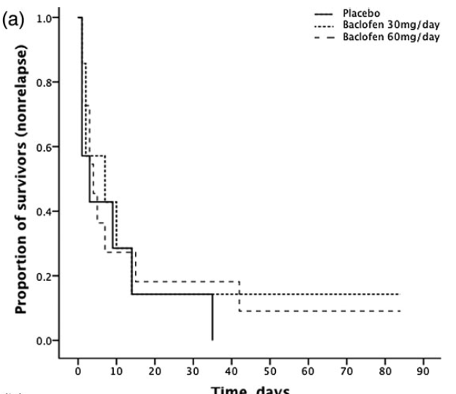
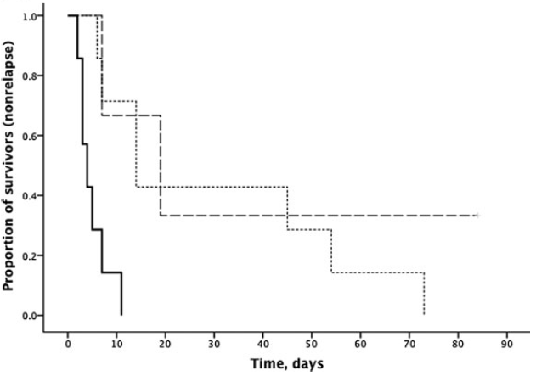
Baclofen: Efficacy
With no comorbid anxiety
With comorbid anxiety

Slide 42
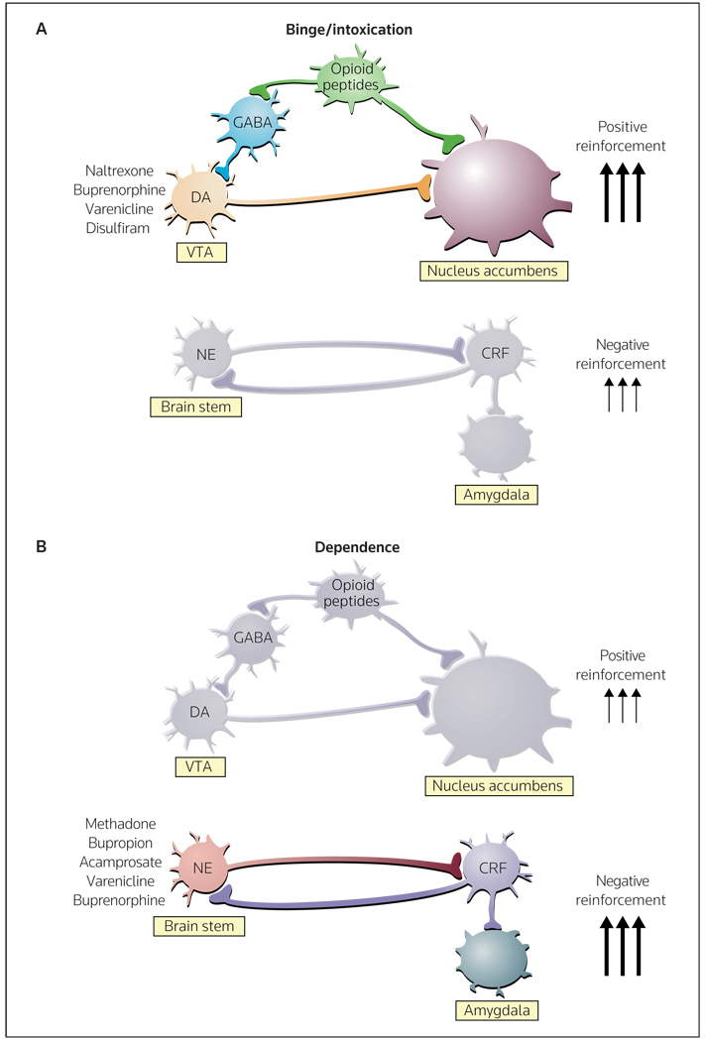
Neurocircuitry associated with pharmacological treatments
Koob & Zorilla, Curr Opin Investig Drugs. 2010; 11(1): 63
Notes:
Neurocircuitry associated with the acute positive reinforcing effects of drugs of abuse and the negative reinforcement of dependence, and changes in the transition from non-dependent to dependent drug-taking(A) Key elements of the reward circuit include dopamine and opioid peptide neurons that intersect at both the VTA (ventral tegmental area) and the nucleus accumbens that are activated during initial drug use and the early binge/intoxication stage of the addiction cycle. Drugs approved for the treatment of this component of the addiction cycle include naltrexone, buprenorphine, varenicline and disulfiram. (B) Key elements of the stress circuit include CRF (corticotropin-releasing factor) and noradrenergic neurons that converge on GABA interneurons in the central nucleus of the amygdala that are activated during the development of dependence. Drugs approved for the treatment of this component of the addiction cycle include methadone, bupropion, acamprosate, varenicline and buprenorphine.
DA dopamine, NE norepinephrine

Slide 43
Summary of drugs used in
Alcohol Use Disorder
Drug | Mechanisms and Dose
Naltrexone Oral Intramuscular injection | µ-Opiate receptors 50–100 mg per day 380 mg per month
Acamprosate | Interfere with conditioned responses 666 mg three times per day
Baclofen | GABA receptors 30-60 mg and above per day
Disulfiram | Trigger aversion 250 mg per day
Topiramate | Inhibit DA increase 300 mg per day
Schuckit, Lancet Jan 2009
Baler & Volkow, TRENDS in Molecular Medicine Vol.12 No.12; 2006

Slide 44
Other medications

Slide 45
Aripiprazole
Aripiprazole functions as a partial agonist at dopamine D2 and 5-HT1A receptors and as an antagonist at the 5-HT2A receptor
Aripiprazole at the same level of efficacy of Naltrexone
Martinotti et al, Journal of Psychopharmacology, 2009

Slide 46
Serotonin and alcohol dependence
Those with early-onset alcoholism may better respond to ondansetron (a 5-HT3 receptor antagonist) than to SSRIs
Those with late-onset alcoholism may respond better with SSRIs
Johnson BA, ALCOHOLISM: CLINICAL AND EXPERIMENTAL RESEARCH, 2000

Slide 47
Potential medications
Target | Agent | Mechanism of Action | Efficacy
Neuropeptides | Antalarmin | CRF1 receptor antagonist | Reduces ethanol consumption and attenuates stress-induced reinstatement of alcohol
Noradrenergic system | Prazosin | α1-Adrenergic receptor agonist | Decreased drinking and stress- and cue-induced alcohol craving
Glutamate | Memantine | NMDA antagonist | Reduced cue-induced craving for alcohol

Slide 48
Pharmacogenetics
Moderating effects of variation in OPRM1 on the response to the opioid antagonist naltrexone
Asp40 allele in a polymorphism in OPRM1, predicted a significantly lower rate of relapse to heavy drinking in naltrexone-treated patients than those receiving placebo
Polymorphisms of the delta and kappa opioid receptor genes (OPRD1, and OPRK1) may contribute to naltrexone's effects
VNTR polymorphism in SLC6A3, which encodes the dopamine transporter protein, moderate the effects of naltrexone

Slide 49
Pharmacogenetics
Disulfiram: DBH T-allele carriers reported fewer drinks per drinking day than C-allele homozygotes
Acamprosate: length of abstinence associated with two polymorphisms (rs2058878, rs2300272) in GRIN2B, which encodes the GluN2B subunit of the NMDA receptor
Topiramate: polymorphisms in GRIK1 to predict adverse events resulting from topiramate treatment
Ondansetron: 5-HTTLPR L-allele homozygotes reported fewer heavy drinking days and more abstinent days
Ondansetron: treatment significantly greater than for placebo in individuals with one or more of the following genotypes: rs1150226-AG and rs1176713-GG in HTR3A, or rs17614942-AC in HTR3B.

Slide 50
Combination of Pharmacotherapy with Psychological therapies
Motivational Enhancement Therapy
Cognitive behaviour therapy
Family therapy
Group therapy
Self help groups – Alcoholic Anonymous

Slide 51
Summary points
Alcohol use disorder has strong neurobiological basis
Pharmacological options are available to suppress alcohol consumption and to reduce cravings
Acamprosate and naltrexone are the most evidence based treatment options as alcohol anti-craving medications
Combining pharmacotherapy with psychological therapies improve effectiveness

Slide 52
Pharmacotherapy for Substance Use Disorder

Slide 53
URINE DRUG SCREEN CUTOFF LEVELS FOR A POSITIVE TO BE REPORTED
DRUG/METABOLITE | INITIAL TEST(ng/ml) | CONFIRMATION (ng/ml)
MARIJUANA | 50
DELTA-9-THC |  | 15
COCAINE | 300 | 150
PHENCYCLIDINE | 25 | 25
AMPHETAMINE | 1000 | 500
METHAMPHETAMINE |  | 500
OPIOIDS | 2000
CODEINE |  | 2000
MORPHINE |  | 2000
6-ACETYL MORPHINE |  | 10

Slide 54
Medications used to manage Substance Use Disorder
Substance of Use | Pharmacological medications
Heroin and Opioids | Methadone; Buprenorphine
Nicotine | Bupropion; Varenicline Nicotine replacement therapy
Cannabis | Compounds containing THC Gabapentin; N-acetylcysteine Bupropion
Cocaine | Disulfiram; Baclofen Modafinil; Topiramate

Slide 55
Relapse Prevention
Residential (drug-free)
Outpatient (drug-free)
Psychological counselling
Support group
Antagonist (eg. naltrexone)
Abstinence
⇐ Relapse
Detoxification
Opioid agonist assisted
Partial agonist assisted
α₂ agonist assisted
Rapid detoxification
Substitution Treatment
Methadone
Buprenorphine
Cessation ⇒
Harm Reduction
Outreach
Education about overdose
HIV risk reduction info
NSP, Condoms, IEC
Safer sex and drug use info
Heroin use
Dependence
Adapted from Ali & Gowing, 2001.

Slide 56
Short Acting Opioids - Heroin
Source : DOLE, V.P. & NYSWANDER, M.E., Pharmacological Treatment of Narcotic Addiction (The Eight Nartan B. Memorial Award Lecture), NIDA, 1982.

Slide 57
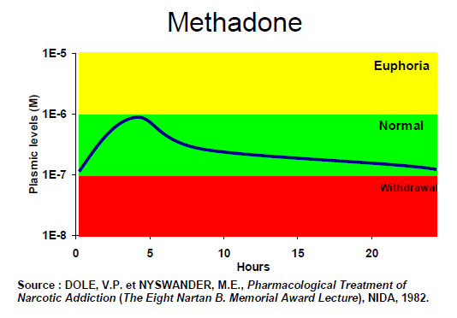
Long Acting Opioids

Slide 58
Opioid Substitution Therapy (OST)
Objective | Target population | Responsible agencies, sectors
OST as HIV prevention | IDUs | NACO, SACS Government hospitals NGOs Private Sector
OST to improve treatment adherence to ART and TB DOTS | IDUs | NACO, SACS ART Centres RNTCP Government hospitals NGOs Private Sector
OST as drug dependence treatment | Opioid dependent persons (includes both IDUs and non-injecting drug users) | MoH supported drug treatment centres MSJE supported drug treatment facilities Private sector

Slide 59
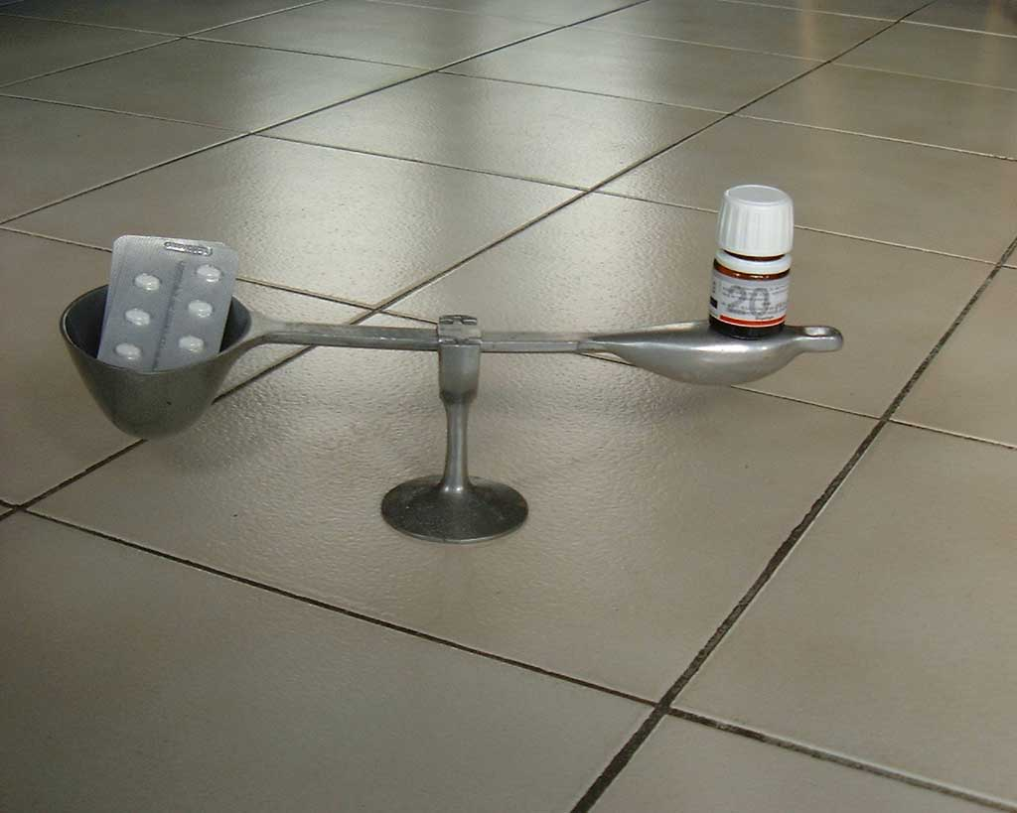
Two most commonly used and popular substitution drugs
Buprenorphine
Methadone
Frederic Sorge, 2001

Slide 60
Methadone and Buprenorphine
Buprenorphine | Methadone
Partial agonist at μ-opioid receptor and produces only a low level of euphoria | Full agonist at μ-opioid receptor and can produce significant intoxication
Low dependence potential | Potential to produce significant dependence
At high doses, there is a ceiling effect. The risk of respiratory depression is minimal, except when combined with benzodiazepines, alcohol and other CNS depressants | Risk of fatal overdose by respiratory depression

Slide 61
Methadone and Buprenorphine
Buprenorphine | Methadone
Sublingual tablets are effectively absorbed. It is not orally active. Sublingual tablets can be crushed, easily dissolved and injected | Orally active
Relatively expensive | Cheaper

Slide 62
Why is Buprenorphine preferred?
Safety
Relatively low level of physical dependence
Mild withdrawal symptoms (though protracted)
Long half-life - need not be taken every day
Good substitute drug for people with mild to moderate opioid dependence
Liked by the clients; carries less stigma
Flexible administration schedule
Favourable drug-drug interactions

Slide 63
Replacement or Substitution therapy is the way forward
Harm reduction principle
Nicotine replacement
Opioid substitution therapy
Amphetamine substitution

Slide 64
Summary Points
Substance use is a chronic relapsing syndrome
The harms associated with substance use are multiple
Reducing harms related to substance use is a public health priority
Pharmacological intervention is an important component of comprehensive interventions for substance users

