Slide 1
How to get your manuscripts published in quality journals
Samir Kumar Praharaj, MD, DPM
Associate Professor, Psychiatry
KMC, Manipal
South Zone PG CME 2015

Slide 2
Outline
Why publish
What to publish
Where to publish
How to publish
Practical Tips

Slide 4
Why publish?
Mandatory requirement
Improve CV
Incentives
Feels good
Learn by doing
Contribute to science

Slide 5
Why not publish?
‘They’ll dismiss my work outright!’
‘I can’t write!’
‘People will steal my ideas’
‘I don’t know where to start!’

Slide 6
What to publish?
Journal articles, reviews, viewpoints, debates, case studies, letters, editorials…
Book chapters, books
Newspaper articles
Blogs
?

Slide 7
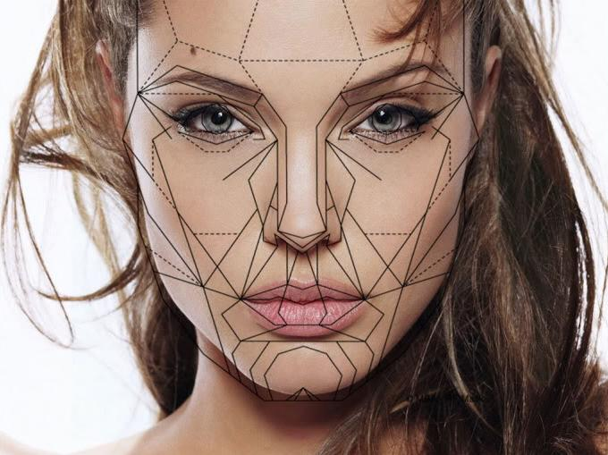

Slide 8
‘There are only two types of articles; those that are perfect and never get published, and those that are good enough and do.’

Slide 9
Never forget that the comments from an editorial review are free, honest and of high quality

Slide 10
Where to Publish?

Slide 11
Quality journal?
Psychiatry journals: 977 (1999 study)
94 Psychiatry journals were
indexed in ISI and 141 in Medline (2007)
Rotten eggs?

Slide 12
The journal is indexed with Caspur, CNKI (China National Knowledge Infrastructure), DOAJ, EBSCO Publishing's Electronic Databases, Excerpta Medica / EMBASE, Expanded Academic ASAP, Genamics JournalSeek, Google Scholar, Health & Wellness Research Center, Health Reference Center Academic, Hinari, Index Copernicus, Indian Science Abstracts, IndMed, National Science Library, OpenJGate, PrimoCentral, ProQuest, PubMed, Pubmed Central, Science Citation Index, SCOLOAR, SCOPUS, SIIC databases, Summon by Serial Solutions, Ulrich's International Periodical Directory and Web of Science

Slide 13
The journal is indexed with Caspur, CNKI (China National Knowledge Infrastructure), DOAJ, EBSCO Publishing’s Electronic Databases, Excerpta Medica / EMBASE, Expanded Academic ASAP, Genamics JournalSeek, Google Scholar, Health & Wellness Research Center, Health Reference Center Academic, Hinari, Index Copernicus, Indian Science Abstracts, IndMed, National Science Library, OpenJGate, PrimoCentral, ProQuest, PubMed, Pubmed Central, Science Citation Index, SCOLOAR, SCOPUS, SIIC databases, Summon by Serial Solutions, Ulrich's International Periodical Directory and Web of Science

Slide 14
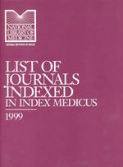
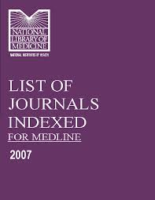
What is an indexed journal?
Index Medicus
MEDLINE/PubMed

Slide 15
Other indexation services
EMBASE
(Excerpta Medica dataBASE)
PsychINFO
(American Psychological Association)
Web of Science
(Thomson Reuters)
SCOPUS
(Elsevier)

Slide 16
Some more indexation services…
Caspur
CNKI (China National Knowledge Infrastructure)
DOAJ
Expanded Academic ASAP
Genamics Journal Seek
Hinari
Index Copernicus
Open J Gate
Primo Central
ProQuest
SCOLOAR etc.

Slide 17
MEDLINE/PubMed
US National Library of Medicine premier bibliographic database
4,900 journals in 30 languages
FREE
PMC – free articles

Slide 18
Indexed, but…?

Slide 19
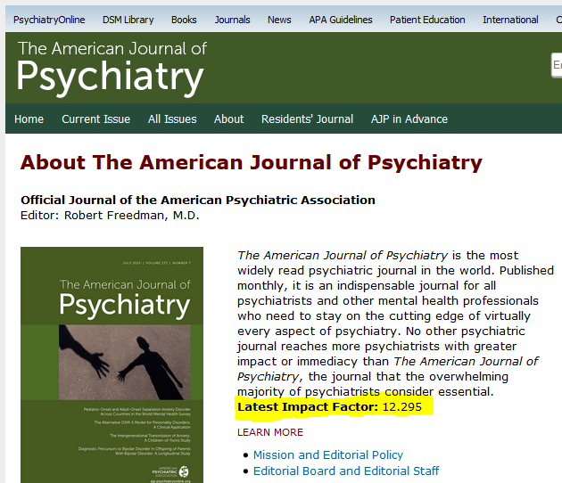
Indexed, but…?

Slide 20
Impact Factor (IF)
Eugene Garfield (Science 1955)
Institute for Scientific Information (ISI) - Journal Citation Report
Thomson Scientific (1992)
“Ratio between citations and
recent citable items published”

Slide 21
How do we calculate Impact Factor?

Slide 22
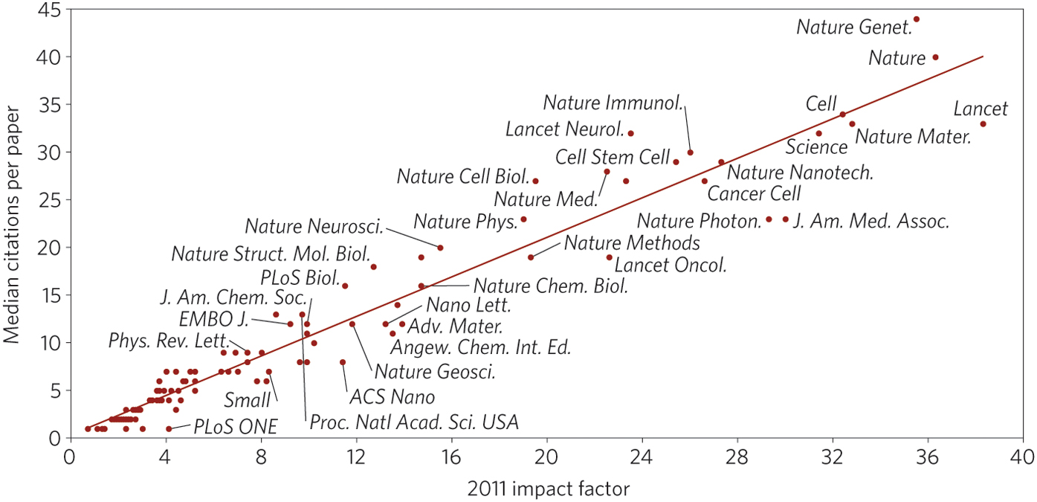
Journal IF is a good predictor of the quality of journals
Editorial, Nature Materials 2013

Slide 23
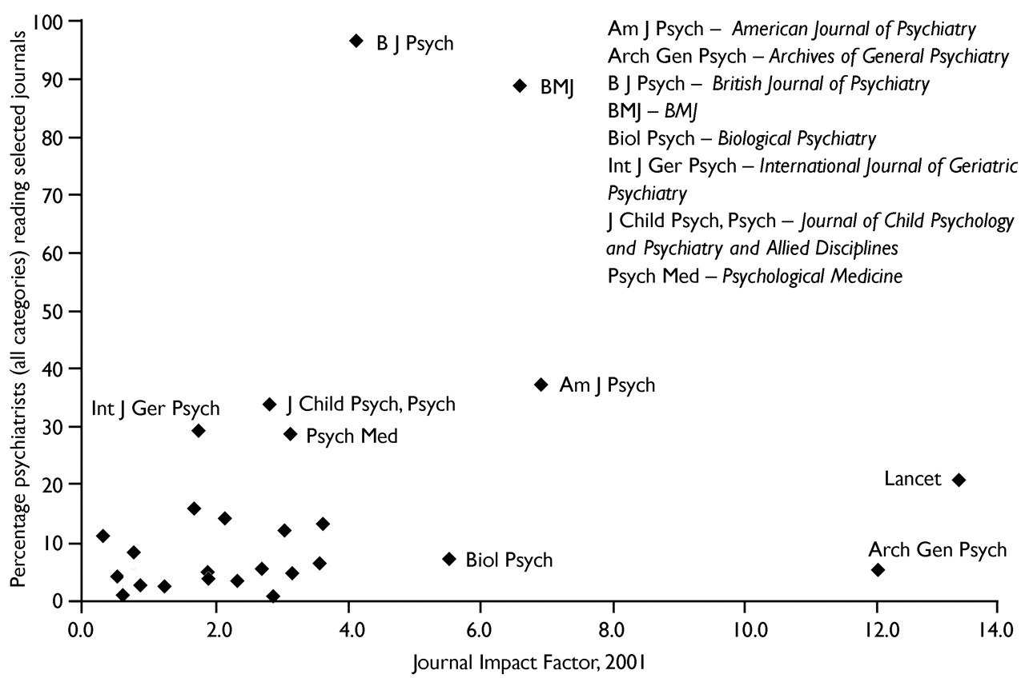
What British Psychiatrists Read?
Jones et al., BJP 2014

Slide 24
Criticisms of IF
Citation for individual articles varied
Review articles cited more frequently
‘Super classics’
‘Methods’ articles - more citations
Different specialties - different peak impact
More letters - temporary increase in references to those letters
Self-citations
Title change affects IF for two years after the change

Slide 25
Other Reliable Indices…
Google Scholar Metrics
Eigenfactor Score and Article Influence Score
Who’s the publisher?
Editorial Board
Journal Acceptance/Rejection Rates
Peer-Reviewed?
Are publication fees required?

Slide 26
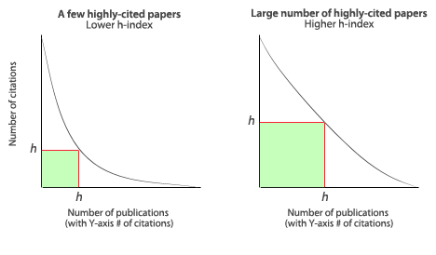
Google Scholar Metrics (GSM)
Academic footprint: h-index, i10-index
Arranges journals based on h5-index and h5-median

Slide 27
Eigenfactor Score & Article Influence Score
Jevin West
Carl T. Bergstrom

Slide 28
Who’s the publisher?

Slide 29
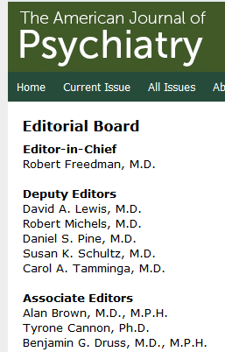
Editorial Board

Slide 30
Journal Acceptance/Rejection Rates
Cabell’s Directory of Publishing Opportunities
UlrichsWeb Global Serials Directory

Slide 31
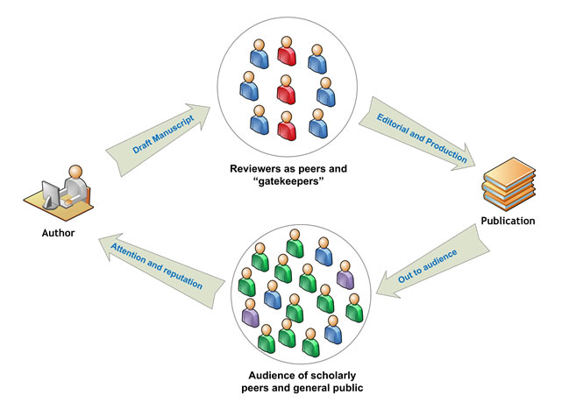
Peer Review Process

Slide 32
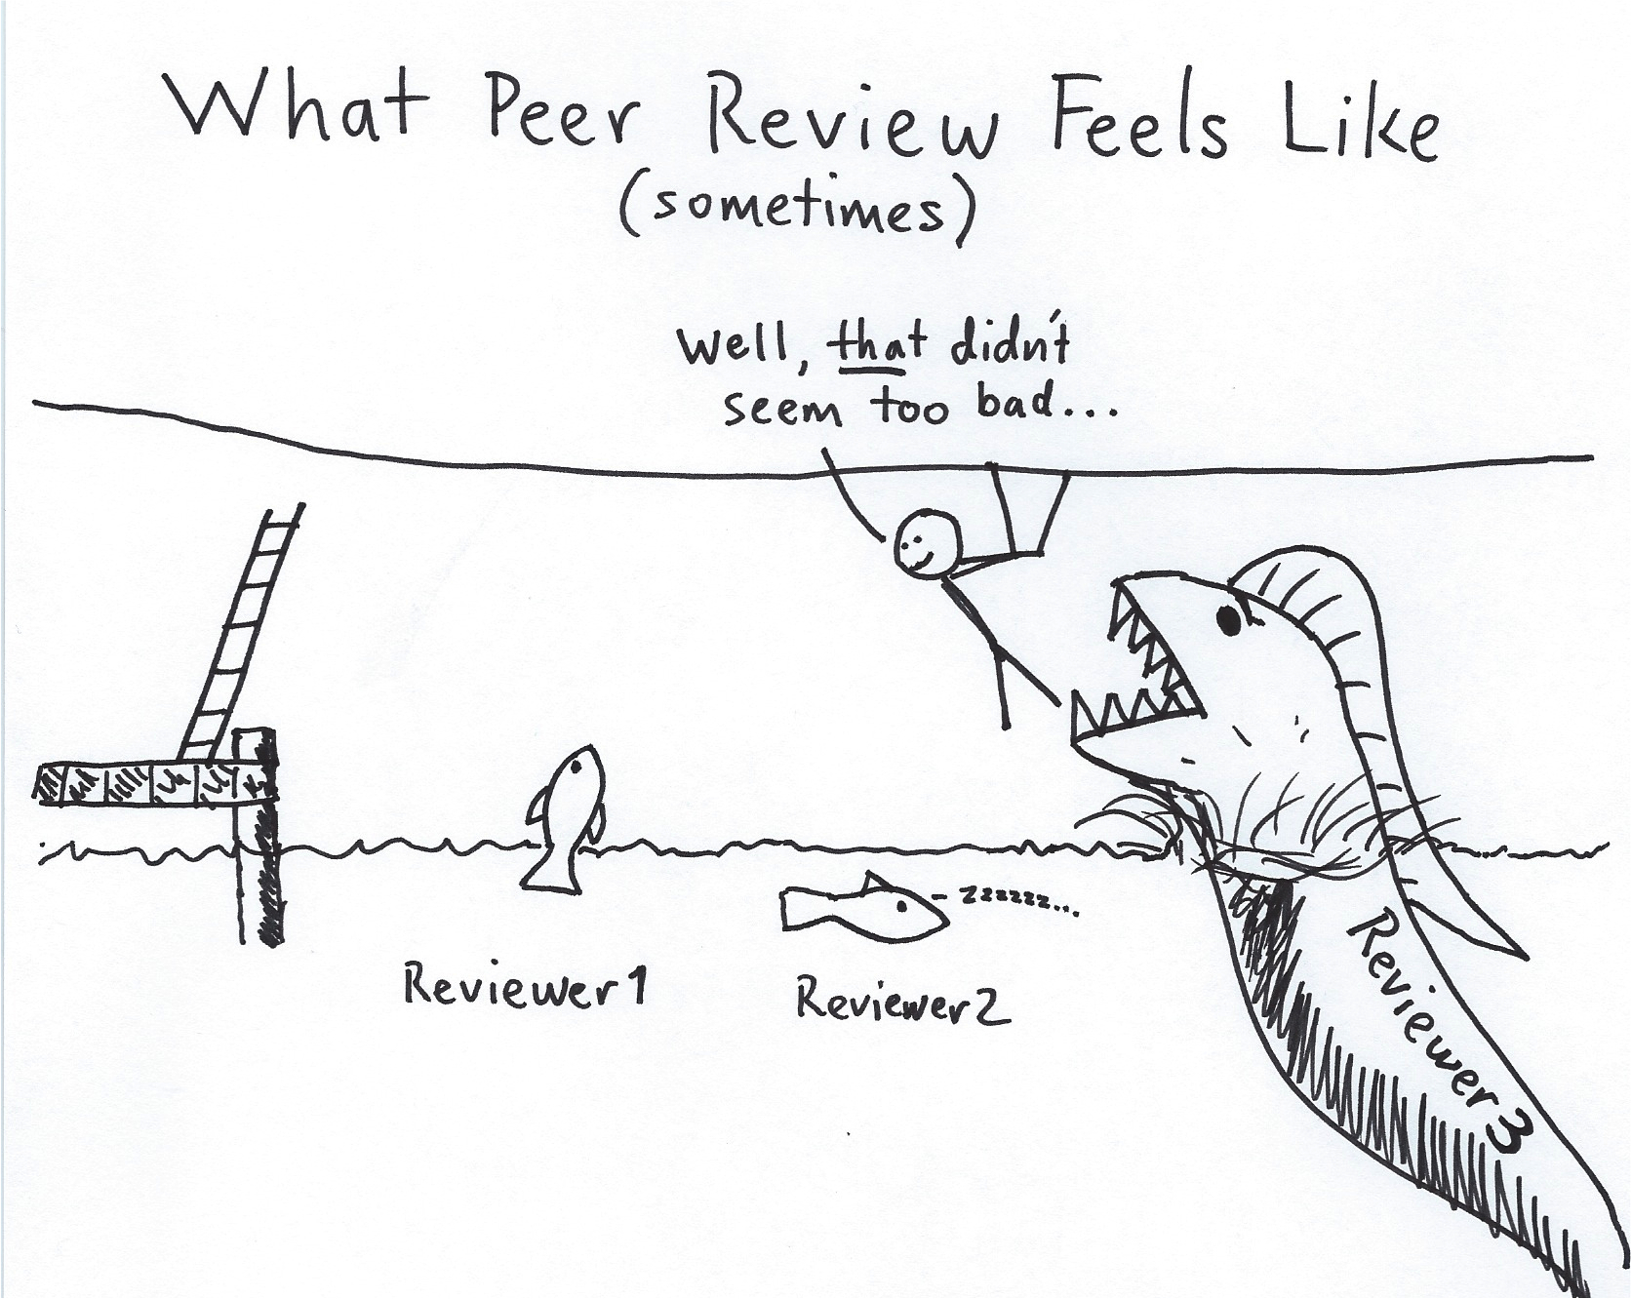

Slide 33
Are publication fees required?
All paid journals are not necessarily bad!

Slide 34
Transparency & Best Practice
publicationethics.org
doaj.org
oaspa.org
wame.org

Slide 35
Principles of Transparency
Peer review
Editorial board
Author fees
Copyright
Research misconduct
Ownership and management
Website, access, revenue source, advertising
Publishing schedule, archiving, marketing

Slide 36
Criteria for Determining Predatory Open-Access Publishers
Editor and Staff
Business management (Publisher): e.g. fleet journals
Integrity: e.g. fake IF, spam peer review
Poor journal standards / practice: e.g. broad journals
Jeffrey Beall 2015
http://scholarlyoa.com

Slide 37
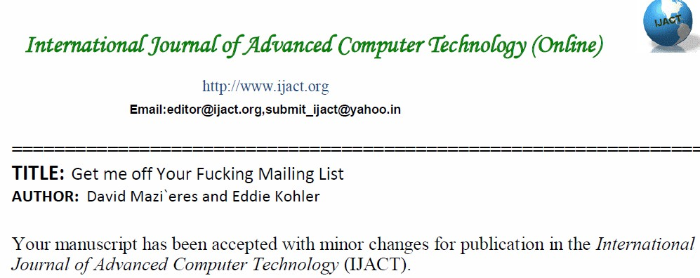
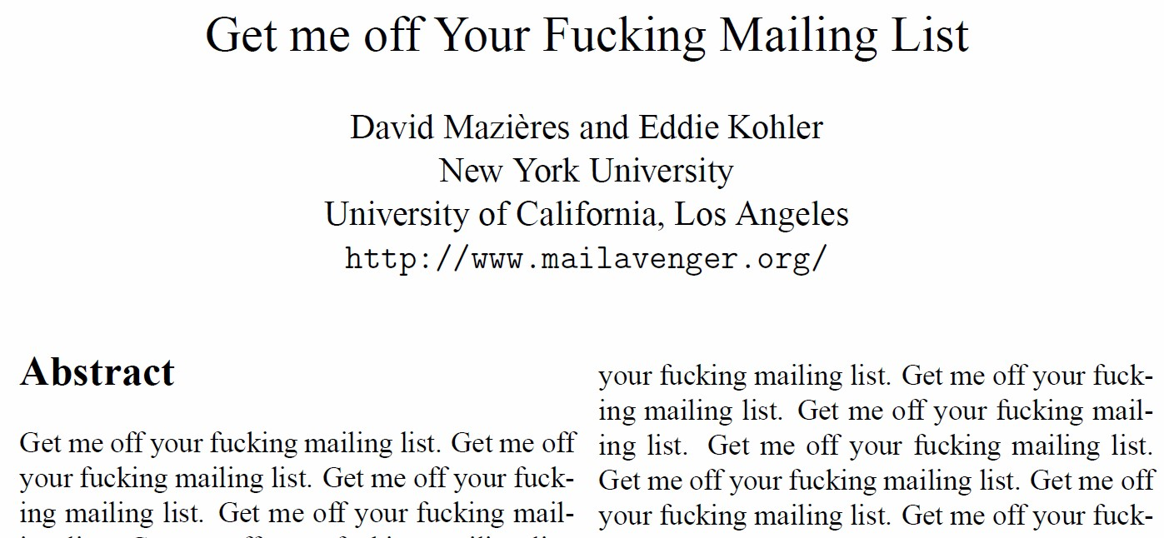

Slide 38
Beall’s List (scholarlyoa.com) Potential, possible, or probable predatory scholarly open-access
List of Publishers (843)
Academic and Scientific Publishing
Academic Journals
Academic Journals and Research ACJAR
Academic Journals Online (AJO)
Academic Journals, Inc.
Academic Knowledge and Research Publishing
Academic Publications, Ltd.
Academic Research Journals
List of Standalone Journals (712)
Indian Journal of Advanced Nursing (IJAN)
Indian Journal of Applied-Basic Medical Sciences
Indian Journal of Applied Research
Indian Journal of Drugs
Indian Journal of Pharmaceutical and Biological Research (IJPBR)
Indian Journal of Pharmaceutical Science & Research (IJPSR)
Indian Journal of Research in Pharmacy and Biotechnology (IJRPB)
Indian Journal of Scientific Research (IJSR)

Slide 39
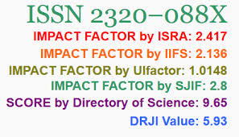
Fake indices…
International Impact Factor Services (IIFS)
Universal Impact Factor (UIF)
Global Impact Factor (GIF)
Journals Impact Factor (JIFACTOR)
Cosmos Impact Factor
IndexCopernicus
Citefactor

Slide 40
Other factors to consider…
Time to publish
Cost

Slide 41
How to publish?
Author: ‘Can I get my paper accepted in this journal?’
Editor: ‘Does it meet the aims of the journal and its audience?’
Reviewers: ‘Is it the right quality?’
Publisher: ‘Is the journal performing to market expectations?’
Reader: ‘Where can I read it? Is it useful to me?’

Slide 42
Understand the Editors
Send the right paper to the right journal!

Slide 43
Understand the Editors
Send the right paper to the right journal!
Understand the aims of the journal
Conform to specifications given in the Notes for Authors
Refer when appropriate to other papers in the same journal

Slide 45
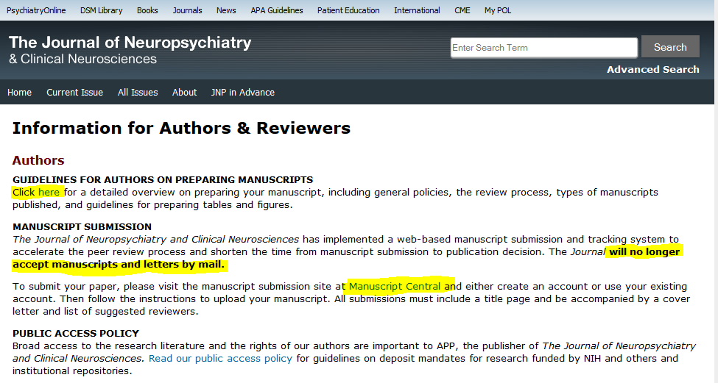

Slide 46
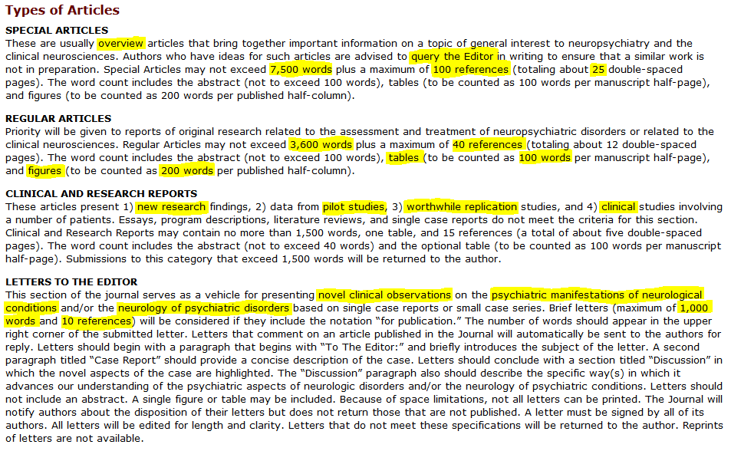

Slide 47
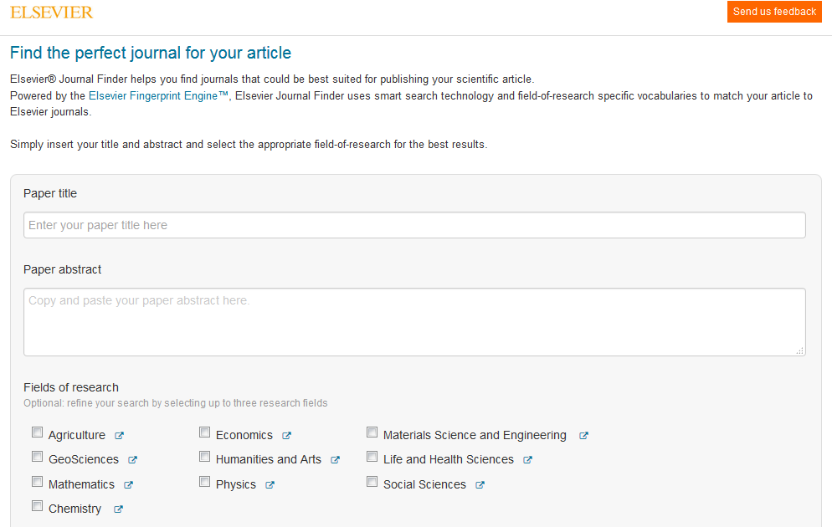
Journal Finder Tool

Slide 48
“Right journal” - Tips
Reference list
Ask colleagues/seniors
Review recent papers in candidate journals
Shortlist journals
Arrange in order according to choice
Discuss with coauthors

Slide 49
Some more practical tips…
Unless you have a great paper, do not submit to journals…
With very high IF, Fake IF etc.
But, find a journal with high enough IF!
Ensure that there are no plagiarized portions in the manuscript

Slide 50
Matching Journals
Psychopathology research
Compr Psychiatry
Psychopathology
Psychiatry Res
J Psychiatry Res
Acta Psychiatr Scand
Aus NZ J Psychiatry
Eur Psychiatry
Psychol Med
World Psychiatry
Can J Psychiatry
Asian J Psychiatry
Schizophrenia
Schizophr Bull
Schizophr Res
Clin Schizophr Relat Psychoses

Slide 51
Matching Journals
Alcohol, Drug abuse
Addiction
J Subs Abuse
Am J Addiction
J Addict Med
Drug Alcohol Dep
Alcohol Alcohol
Consultation-Liaison
Psychosomatic Med
Psychosomatics
J Psychosomatic Res
Gen Hosp Psychiatry
Mood disorder
Bipolar Disord
J Affect Disord
Depress Anxiety

Slide 52
Matching Journals
Drugs
J Clin Psychopharmacol
J Clin Psychiatry
Prog Neuropsychopharmacol Biol Psychiatry
Int Clin Psychopharmacol
J Child Adolesc Psychopharmacol
Psychopharmacol (Berl)
Hum Psychopharmacol
Clin Neuropharmacol
J Psychopharmacol
Ther Adv Psychopharmacol
Cur Drug Saf
Br J Clin Pharmacol
Qualitative studies
Transcult Psychiatry
Cult Med Psychiatry

Slide 53
Case reports
Some journals do not publish/have stopped
Can J psychiatry
Prog Neuropsychopharmacol Biol Psychiatry
As letters only (500 words)
Am J Psychiatry
Longer ones, but specific content
J Clin Psychopharmacol
Clin Neuropharmacol
J Child Adolesc Psychopharmacol
Ann Pharmacother
Journal for case reports!
BMJ Case Rep
Am J Case Rep

Slide 54
Letters…good way to start
Read recent papers
“Critically evaluate”
Read again if anything strikes you
“Aha” moment
Read relevant literature
Write, edit, submit!

Slide 55
Book reviews/Movie reviews
Be the first to review!

Slide 56
Time consuming…
Reviews
Systematic Reviews
Original studies

Slide 57
Understand the Editors
Keep in touch
Acknowledge everything immediately
Respond promptly with requests for revision, corrections
Assist with administration
Keep to deadlines
Complete all documentation fully and promptly
Supply the finished paper precisely to specification
Don’t amend proofs, other than production errors

Slide 58
Understand the Reviewers
Edit according to journal style
Type of article, Word limit, Subheadings
References
Spelling and grammar
Rebuttal to comments
Thank their efforts
Point by point
Highlight changes in text/ Tracker function

Slide 59
Understand the Reviewers
Follow guidelines
CONSORT (Consolidated Standards of Reporting Trials)
SPIRIT (Standard Protocol Items: Recommendations for Interventional Trials)
STROBE (STrengthening the Reporting of OBservational studies in Epidemiology)
PRISMA (Preferred Reporting Items for Systematic Reviews and Meta-Analyses)
STARD (Standards for Reporting of Diagnostic Accuracy)
COREQ (Consolidated criteria for reporting qualitative research)
ENTREQ (Enhancing transparency in reporting the synthesis of qualitative research)
CARE (Consensus-based Clinical Case Reporting)
SAMPL (Statistical Analyses and Methods in the Published Literature)

Slide 61
Suggestions for reviewers
Don’t give
friends/colleagues names
wrong information
Authors who have worked in the area
Check from your reference list
Contact information (e-mail)
Reason for choosing

Slide 62
Understand the Readers
Introduction
short, to the point
Include recent studies (MA>RCT>Other)
Methods
Explain in sufficient detail
Results
Figures/Tables as necessary
Discussion
Build new hypotheses

Slide 63
Summary
Prepare manuscript well before you submit
Show to friend/colleague/seniors
English language editing
Submit to relevant journal with high IF
Do not get disheartened with rejection
Make use of reviewer’s comments
Resubmit to a journal with lower IF
Repeat the cycle!

Slide 64
Practical Tips
Write, Write, Write…
…as that is the only way to improve!

Slide 65
Any Questions…
samirpsyche@yahoo.co.in

